Slide 1

Workplace Based Assessments in UME
Rotation Orientation, Fall 2024

Slide 2
Workplace Based Assessments
The AFMC has determined 12 Entrustable Professional Activities (EPAs) or clinical skills expected of a graduating medical student in the workplace, independent of specialty
The EPAs comprise one component of workplace-based assessments
Our commitment: to provide frequent coaching in these 12 areas, and to reflect with you on your progress over clerkship
EPAs are credit/no credit and are NOT otherwise used to determine student progress in the program or to determine eligibility for graduation

Slide 3
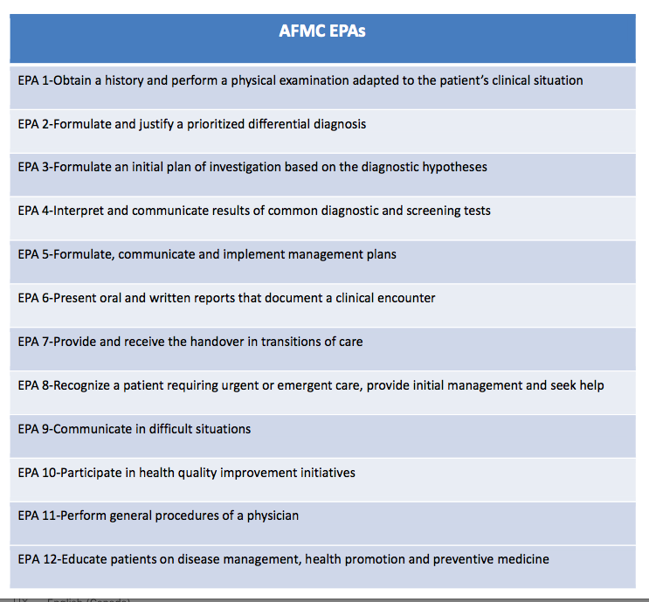

Slide 4
Example- EPA 1: Obtain a history and physical examination adapted to the patient’s clinical situation
Key Observable Behaviours:
Conduct a patient-centred interview, gathering all relevant biomedical and psychosocial information
Communicate using a patient-centred approach that facilitates patient trust and autonomy and is characterized by respect and compassion
Use clear and concise language; avoid or adequately explain medical jargon
Seek and synthesize relevant information from other sources, including the patient's family, with the patient's consent
Optimize the physical environment for patient comfort, dignity, privacy, engagement, and safety
Performs and demonstrates physical exam skills tailored to the clinical case

Slide 5
EPA 8: Recognize a patient requiring urgent or emergent care, provide initial management and seek help
Key Observable Behaviours:
Utilizes early warning signs, or rapid response team criteria, to recognize patients at risk of deterioration and mobilizes appropriate resources urgently
Asks for help when uncertain or requiring assistance; involves team members needed for immediate response and continued follow-up
Initiates and participates in a code response; performs basic life support when required including CPR during cardiac arrest
Rapidly assesses and initiates management to stabilize the patient
Clarifies patient's goals of care upon recognition of deterioration
Updates family members/caregiver/advocate to explain patient's status and escalation-of-care plans

Slide 6
How Does it Work?
Communication is key
  Assessor: What are your learning goals for today?
  Student: I have been working on prioritizing my differential diagnoses. I am hoping to have your feedback during clinic and to complete an EPA (EPA2).”
Coaching conversation after the observation
Documentation using the EPA tool
Students should complete the contextual information on Elentra for faculty or resident/fellow assessors and either hand over their device (preferred) or have Elentra email the assessor with a link
*Expect some variation between courses but EPAs stay the same

Slide 7

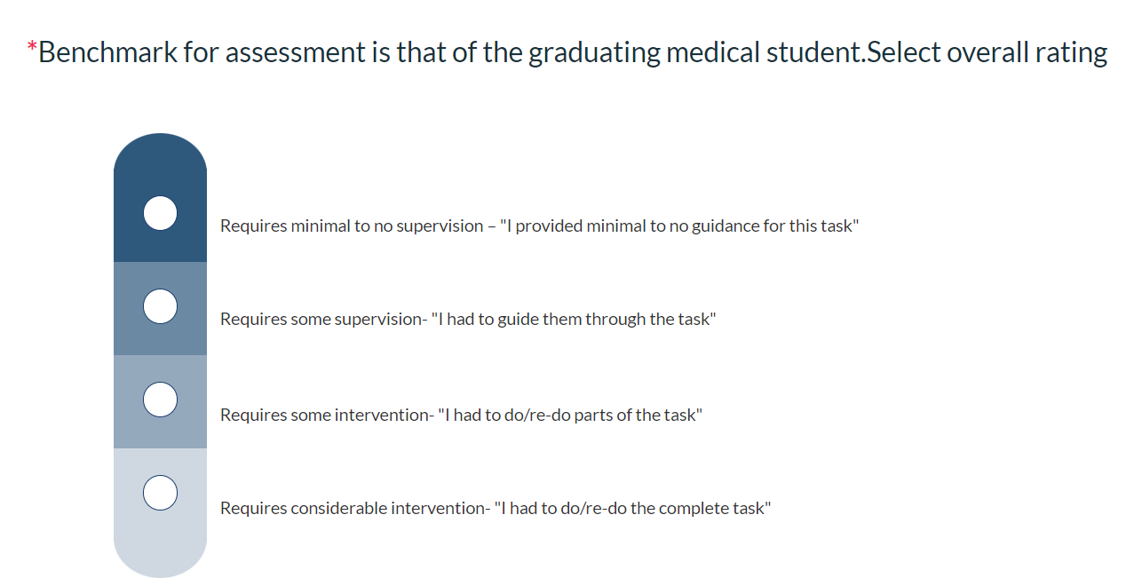
EPA Assessment Scale
Benchmarking- ‘at the level of a graduating medical student’
The entire scale will be used as students move through clerkship.

Slide 8
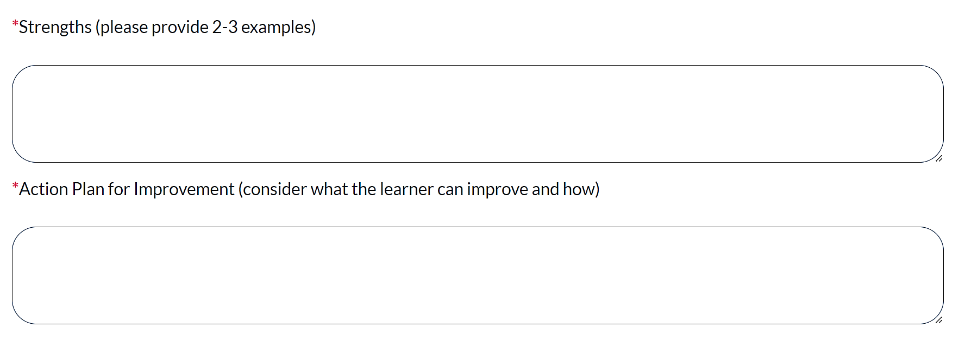
Narrative Feedback
The narrative section captures the verbal feedback provided.
This is the most important part of the EPA!

Slide 9
Exemplars
Feedback | Narrative | Why is this good?
Strengths (EPA 2*) | - comprehensive hx for back pain, particularly seeking out RFs for osteoporosis/compression fractures - utilized CORE Back Tool - clearly stated why malignancy/infection/ inflammatory ds ruled out | - SPECIFIC to encounter - SPECIFIC to EPA - reinforces aspects of performance to continue in future encounters
Action Plan (EPA 11**) | - (Suturing) - Needle 90 degrees to tissue - Proper bites to ensure strong closure - Smaller bites in corners and where closure more challenging -Try palming the needle driver for more control | - SPECIFIC to encounter - SPECIFIC to EPA - clearly outlines aspects of performance to work on in future encounters
*EPA 2- Formulate and justify a prioritizied differential diagnosis
**EPA 11- Perform general procedures of a physician

Slide 10
Requirements (credit/no credit):
1 EPA per week on average (minimum)
  No requirement for our 1-week courses (Ophtho and OHNS)
Residents/fellows may complete 50%
Complete at least one EPA1 in each course (except Anaesthesia)
Always refer to course-specific orientation around requirements
  Reminders will be sent by Elentra and Course Administrators
  Students not meeting the credit requirement will meet with the Course Director to determine a time to return to the course for completion

Slide 11
Course Requirements (subject to change)
Course | Required EPAs (total number: and specific EPAs) | Notes (50% to be completed by Faculty except as noted)
Anaesthesia (2w) | 2 EPAs: #7 and #11 (bag-mask ventilation)
Emergency Medicine (4w) | 3 EPAs: #1, #8, plus | 2 completed by faculty
Family Medicine (6w) | 6 EPAs: #1, plus | 4 EPAs must be directly observed by Faculty
Obstetrics/Gynecology (6w) | 6 EPAs: #1, #11 (pelvic exam), plus | EPAs 1 and 11 must be completed by Faculty
Paediatrics (6w) | 6 EPAs: #1, plus
Psychiatry (6w) | 6 EPAs: #1, plus | 4 EPAs must be clinical encounters directly observed by Faculty (EPAs 1, 5 or 9)
Internal Medicine (8w) | 8 EPAs: #1x2, plus | 2 EPA1s from observed hx/pe exercise; aim for 1 EPA per ambulatory clinic (2-4 in total); no more than 1 EPA from each resident or CTU Attending worked with.
Surgery (8w) | 6 EPAs: #1, #8, plus

Slide 12
How do WBAs benefit students?
Opportunity for:
Further direct observation and feedback to improve performance in the clinical environment (assessment FOR learning, not OF learning)
Longitudinal feedback allows for reflection on progress within and across clerkship courses
Preparation for EPAs in residency

Slide 13

How will the data be used?
The most important component is the coaching conversation around the EPA immediately after the observation for your learning
Completion data will be tracked by administrators for credit/co credit
Narrative feedback from EPAs may inform the final clinical assessment narrative (details in course-specific orientation)
The data will be included in the Learner Chart for reflection at Progress Meetings with Scholars

Slide 14

A shared journey…
Link to Student and Faculty Development Website for more info- newsletters, guides, and a tell-all 10min how-to video:
https://meded.temertymedicine.utoronto.ca/assessing-entrustable-professional-activities-epa-clerkship

